Slide 1


Slide 2

•
•
•
•
•
•
•
Area chart
Bar chart
Data profile (fractile)
Descriptive statistics
Doughnut chart
Frequency distribution
Histogram
Line chart
….
….








Bubble chart
Column chart
Contingency table
Cross-tabulation
Cumulative relative
frequency
•
3-2

Slide 3
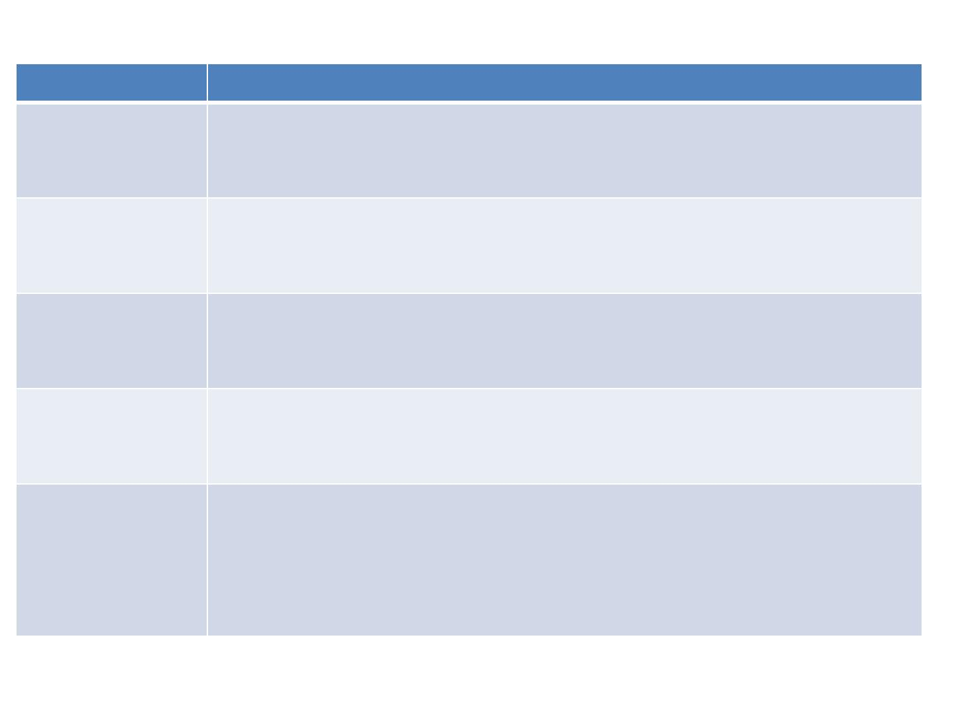
Chart Type
Bar chart
Where /When to use ?
Comparing data across categories. Examples: Volume of shirts in
different sizes, website traffic by origination site, percent of spending by
department.
Viewing trends in data over time. Examples: stock price change over a
five year period, website page views during a month, revenue growth by
quarter.
Line chart
Pie chart
Map
Showing proportions. Examples: percentage of budget spent on
different departments, response categories from a survey, breakdown of
how Indians/Americans spend their leisure time.
Showing geocoded data. Examples: Insurance claims by state, product
export destinations by country, car accidents by zip code, custom sales
territories.
Scatter plot
Investigating the relationship between different variables. Examples:
Male versus female likelihood of having lung cancer at different ages,
technology early adopters’ and laggards’ purchase patterns of smart
phones, shipping costs of different product categories to different
regions.

Slide 4
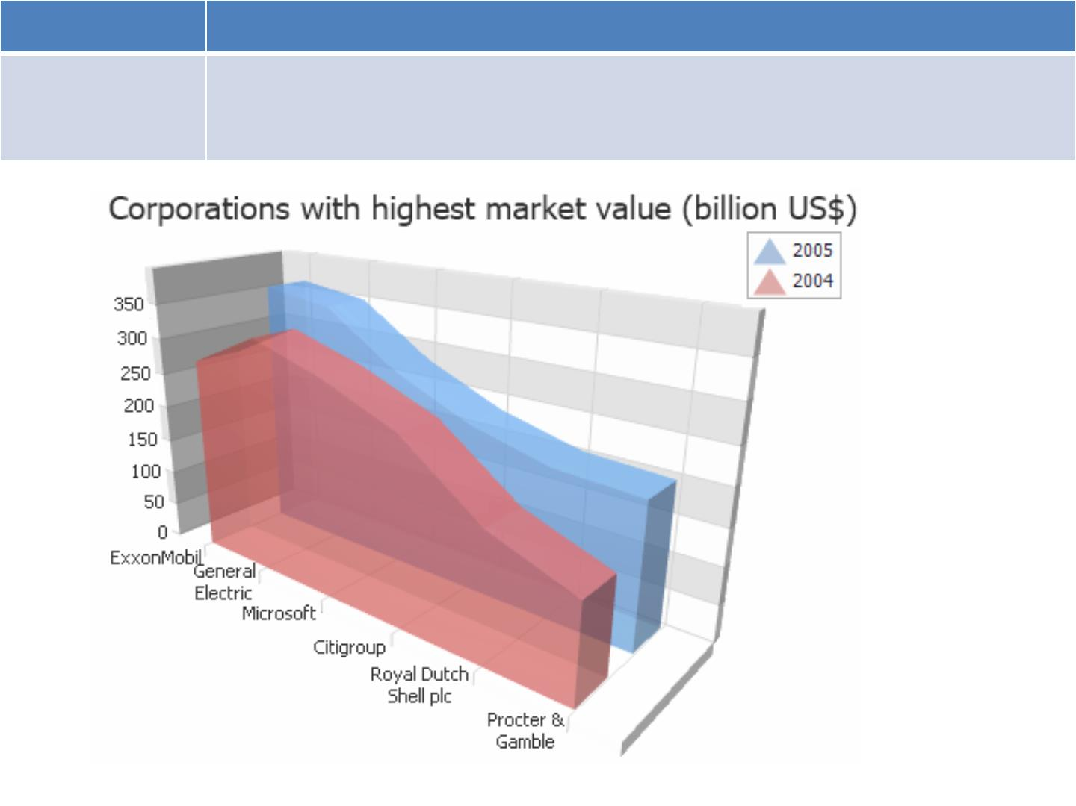
Chart Type Where /When to use ?
3D Area Chart An Area Chart emphasizes the amount of change over a period of time or
compares multiple items. The 3D area chart provides an extra dimension for
plotting data by comparing values along two axes.

Slide 5
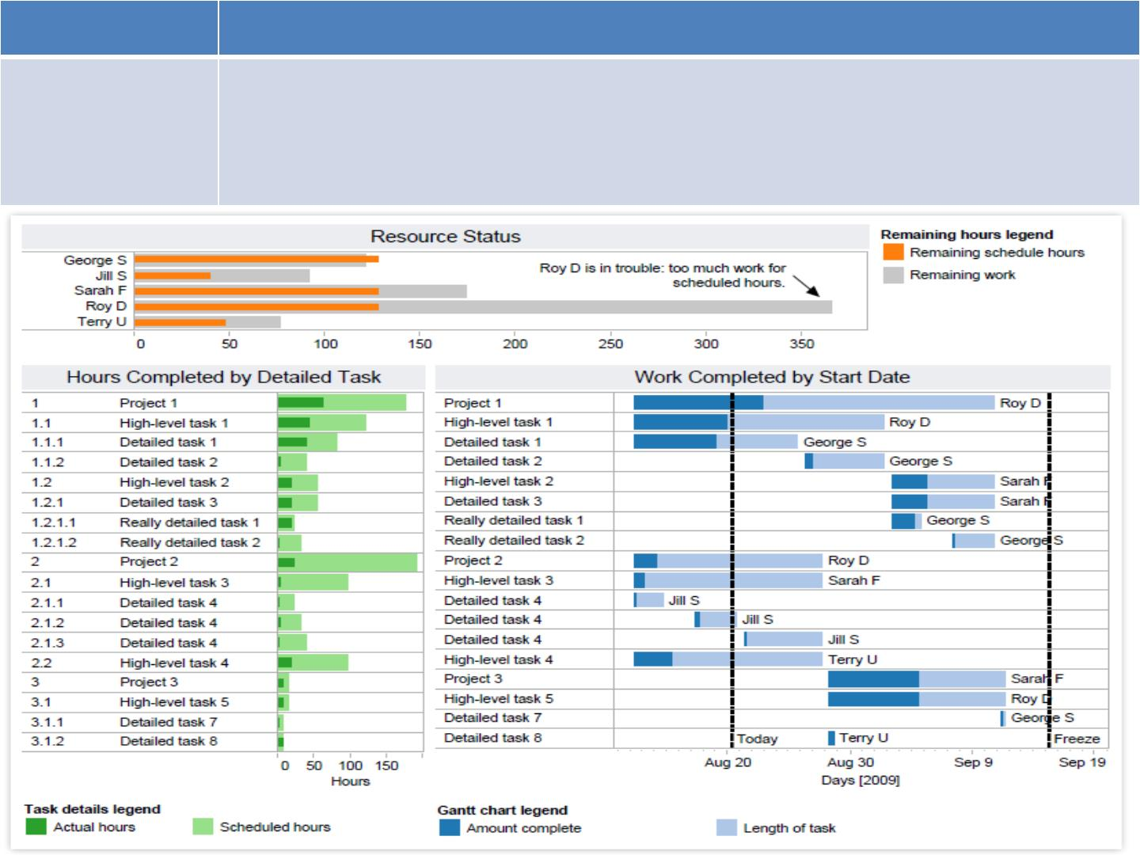
Sairam
Chart Type Where /When to use ?
Gantt chart
• Displaying a project schedule. Examples: illustrating key deliverables,
owners, and deadlines.
Showing other things in use over time. Examples: duration of a machine’s
use, availability of players on a team.
•

Slide 6
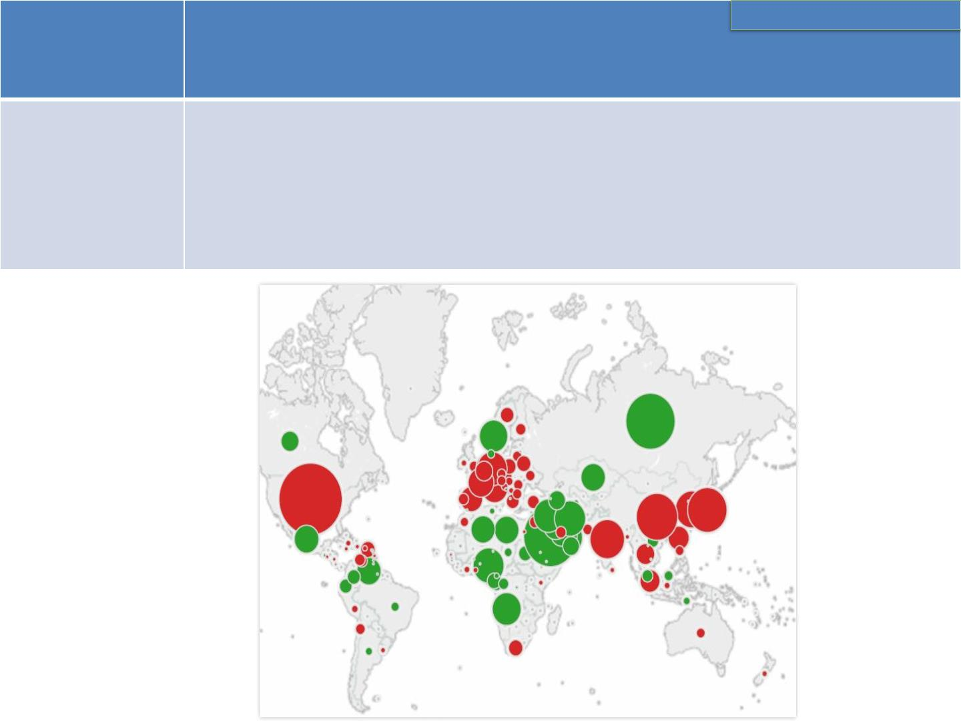
Chart Where /When to use ?
Type
Choosing Appropriate Visuals
Bubble
chart
A bubble chart is a variation of a scatter chart in which the data points are replaced with bubbles, and an additional dimension of the data is represented in the size of the bubbles. Just like a scatter chart, a bubble chart does not use a category axis — both horizontal and vertical axes are value axes.

Slide 7
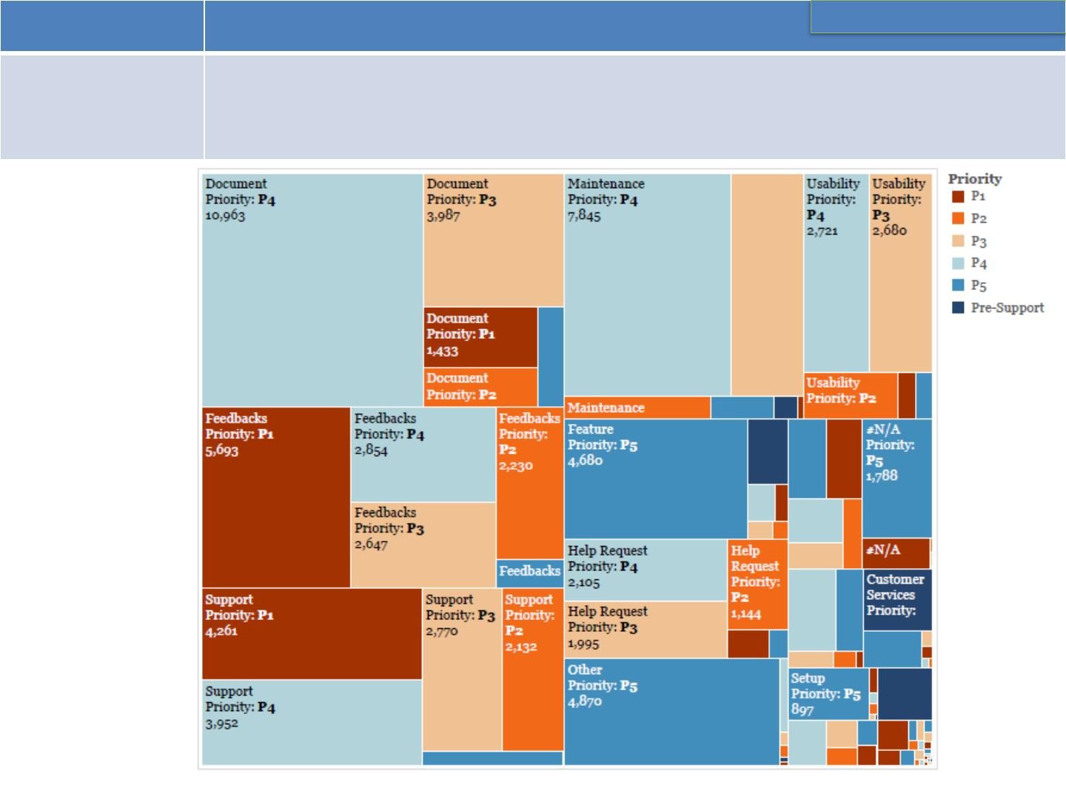
Chart Type Where /When to use ?
Choosing Appropriate Visuals
Treemap
Showing hierarchical data as a proportion of a whole: Examples: storage
usage across computer machines, managing the number and priority of
technical support cases, comparing fiscal budgets between years

Slide 8
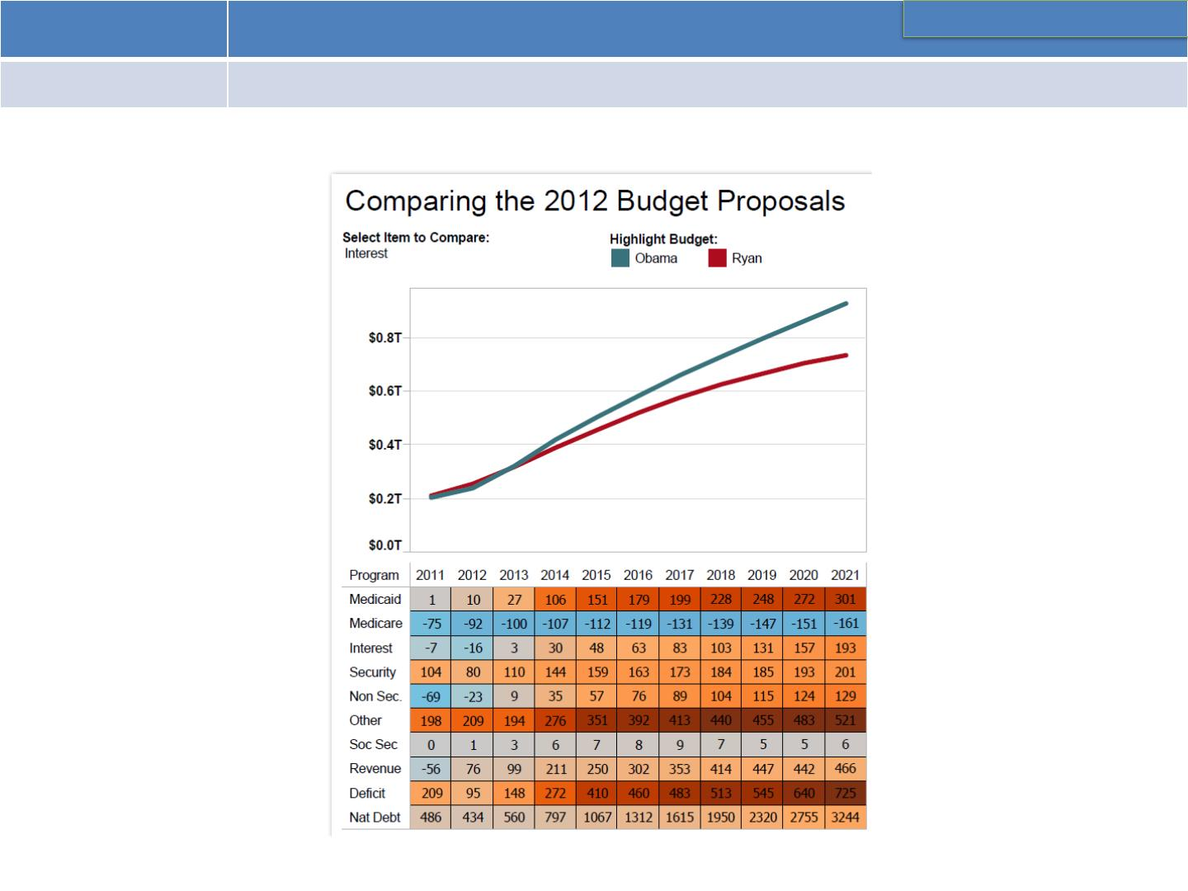
Chart Type Where /When to use ?
Choosing Appropriate Visuals
Highlight table Providing detailed information of heat maps.

Slide 9
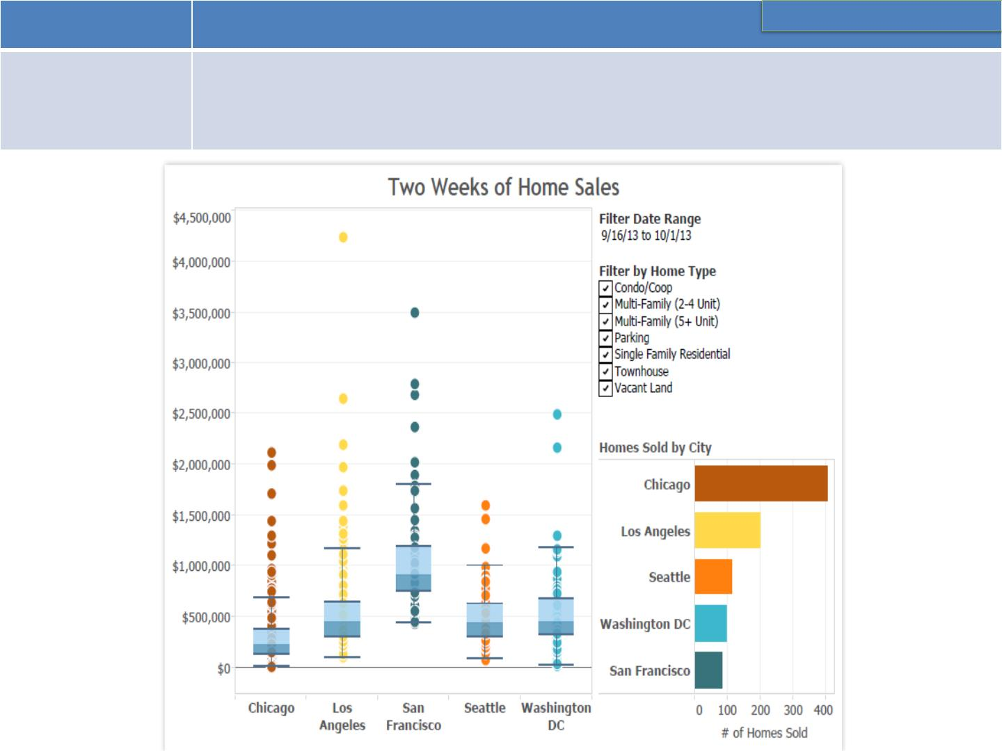
Chart Type Where /When to use ?
Choosing Appropriate Visuals
Box-and-
whisker Plot
Showing the distribution of a set of a data: Examples: understanding your
data at a glance, seeing how data is skewed towards one end, identifying
outliers in your data.

Slide 10
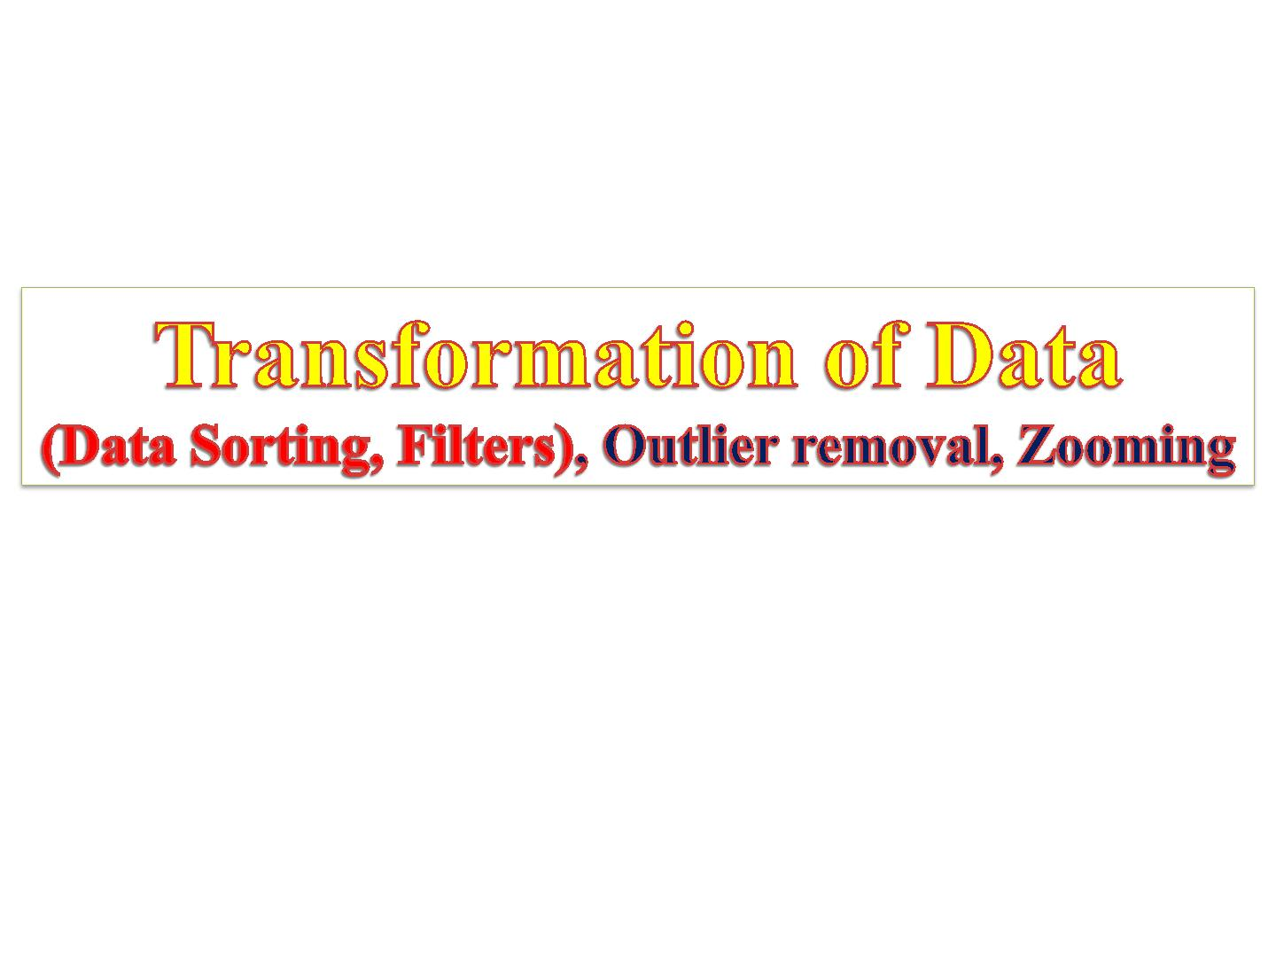

Slide 11

Naturally, with the insights that you have gathered from the last
visualization you might have an idea of what you want to see next.
You might have found some interesting pattern in the dataset which
you now want to inspect in more detail. Possible transformations
are:
Filtering: To (temporarily) remove data points that are not in our
major focus.
Note: may applied at two occasions (mostly during the pre-
processing & when focusing a theme)
Outlier removal: To get rid of single points that is not representative for 99% of the dataset.
Zooming : To have look at a certain detail in the visualization Aggregation To combine many data points into a single group

Slide 12
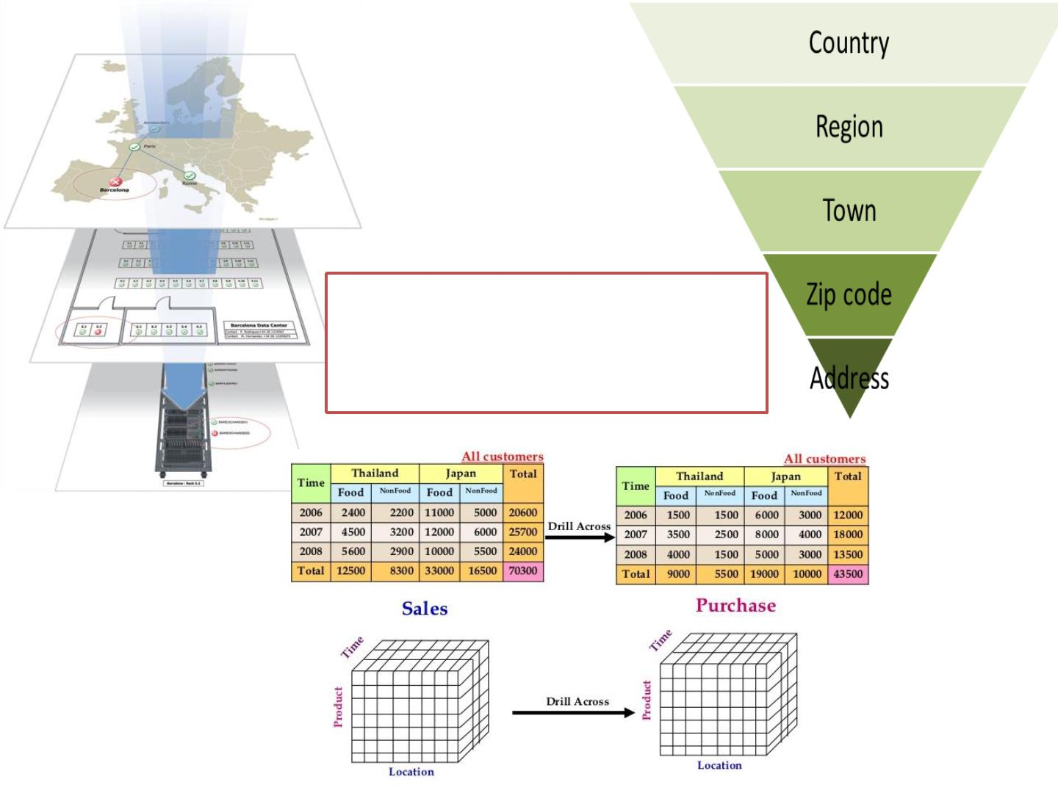
❖
You can drill down, up, or
across
attributes/custom
groups,

Slide 13
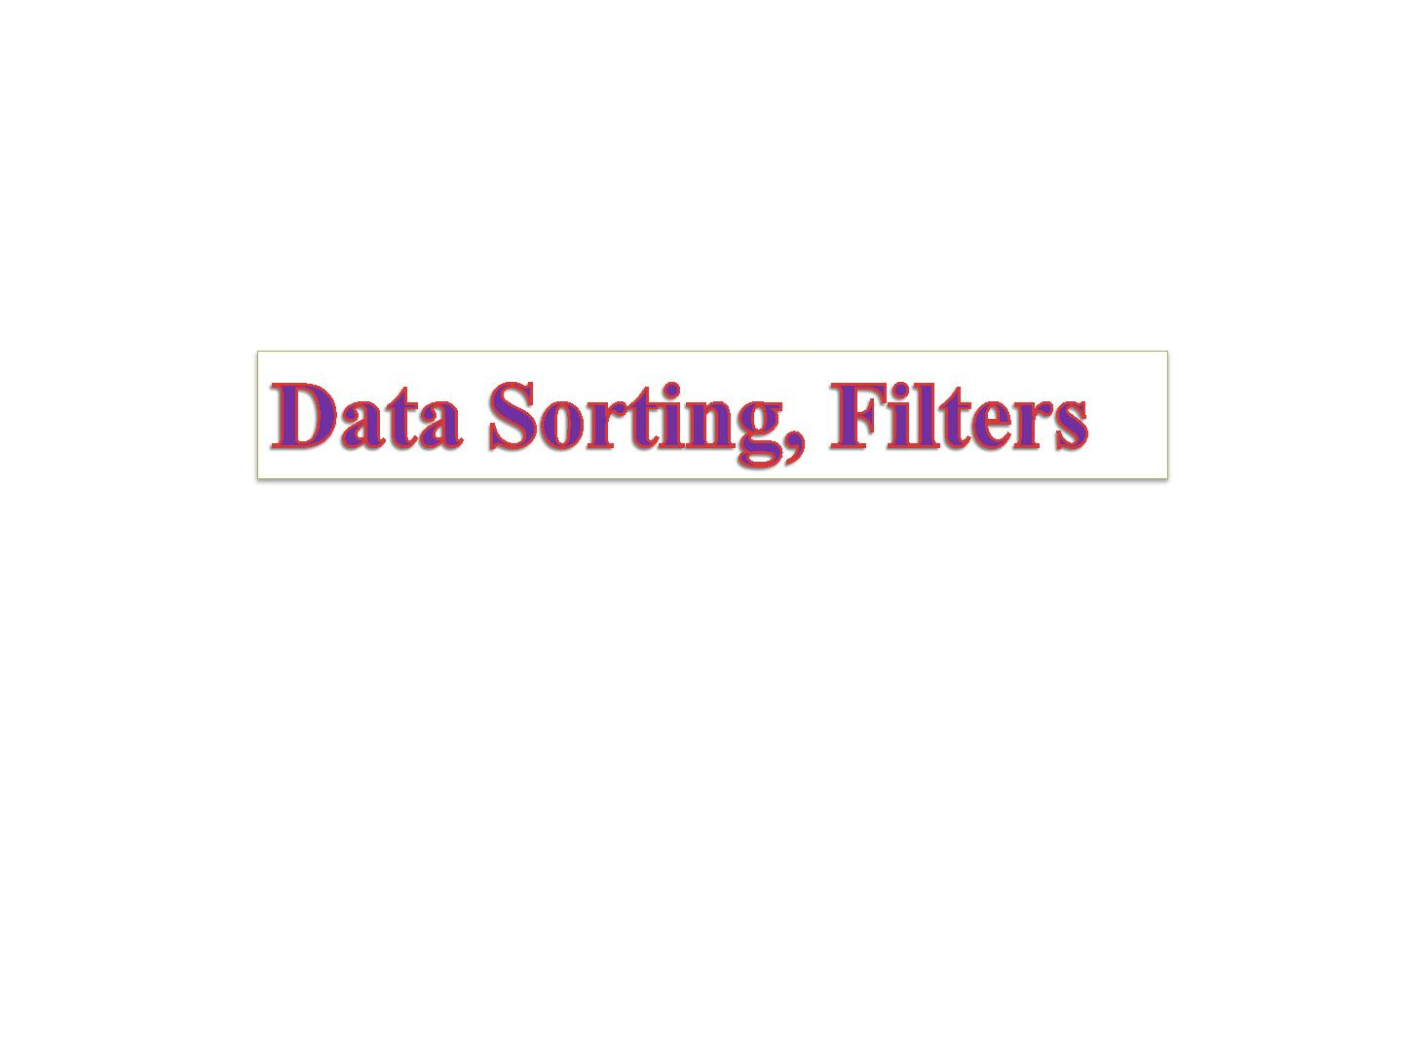

Slide 14
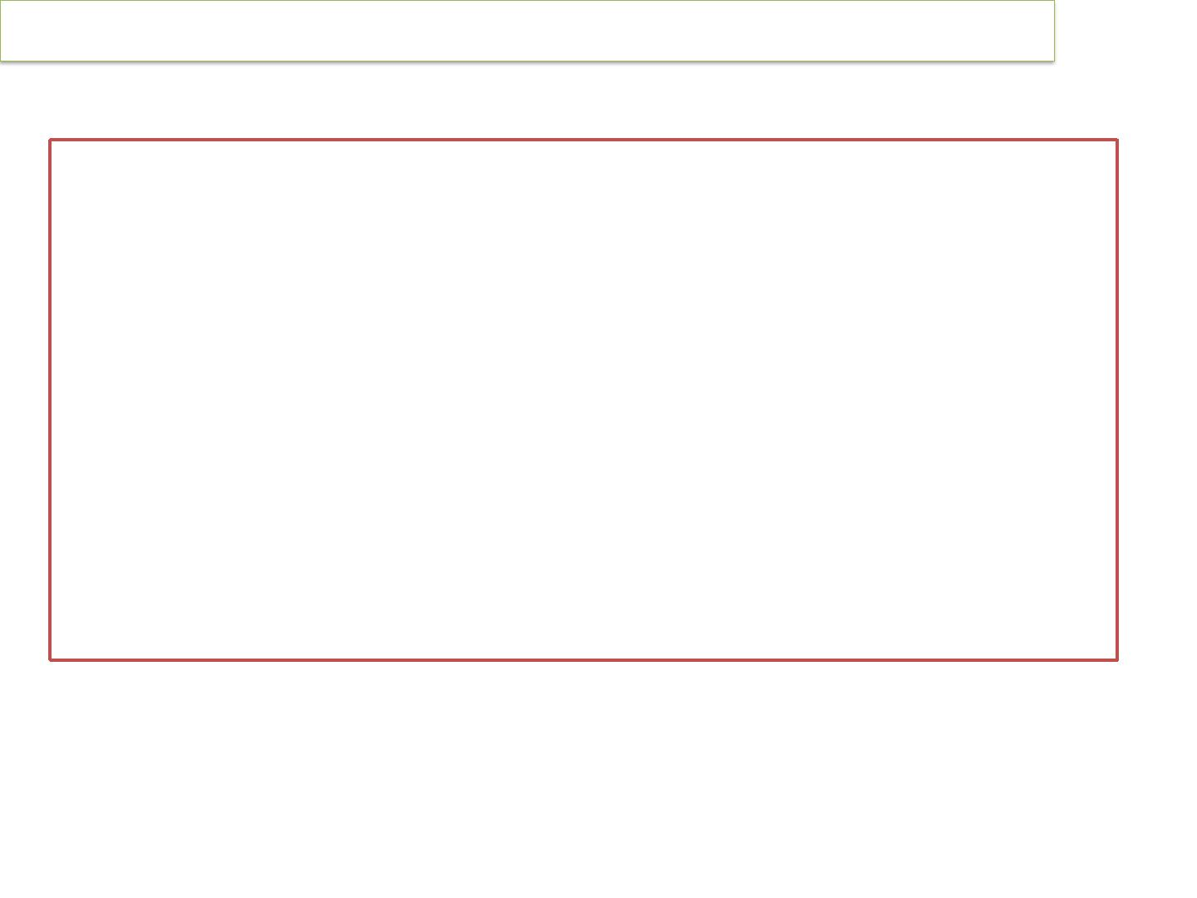
Origin and Relevance of Pareto Analysis (80/20 Rule) with…
Pareto Analysis
An Italian economist, Vilfredo Pareto, observed in 1906
that a large proportion of the wealth in Italy
was owned by a small proportion of the people.
Similarly, businesses often find that a large
proportion of sales come from a small proportion of
customers.
A Pareto analysis involves Filtering, Sorting of
data and calculating cumulative proportions.

Slide 15
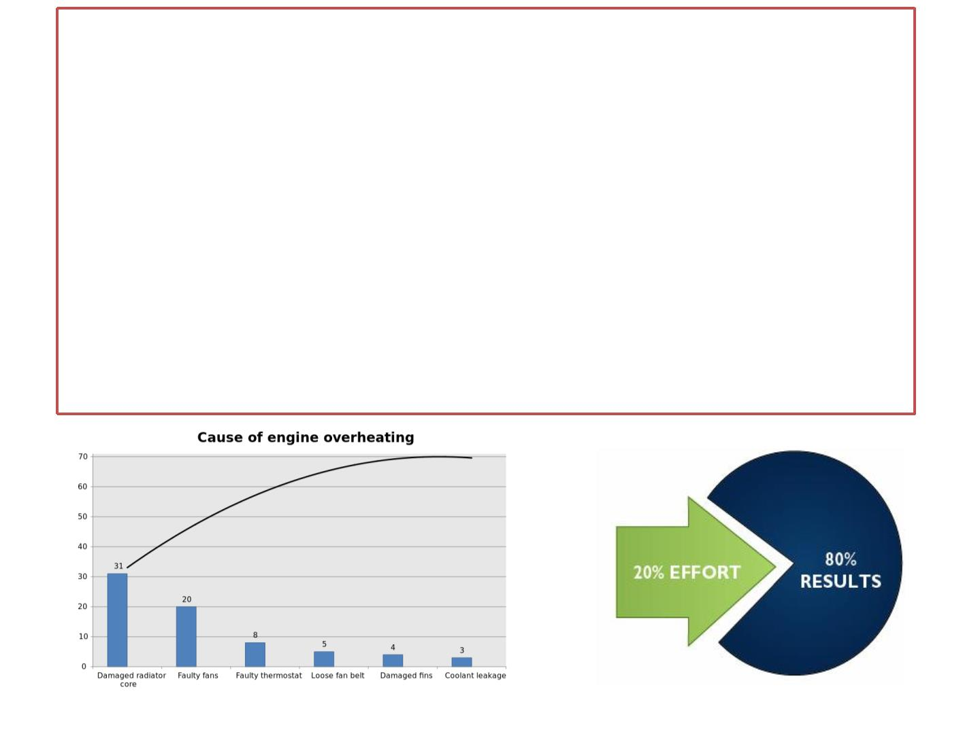
➢
Pareto Analysis is used to record and analyse data relating to a
problem in such a way as to highlight the most significant areas, inputs
or issues.
➢
Pareto Analysis often reveals that a small number of failures are
responsible for the bulk of quality costs, a phenomenon called the ‘Pareto Principle.’
➢ This pattern is also called the ‘80/20 rule’ and shows itself in many
ways. For example:
➢
➢
➢
80% of sales are generated by 20% of customers.
80% of Quality costs are caused by 20% of the problems.
20% of stock lines will account for 80% of the value of the
stock.
A Pareto diagram allows data to be displayed as a bar chart and enables the main contributors to a problem to be highlighted

Slide 16
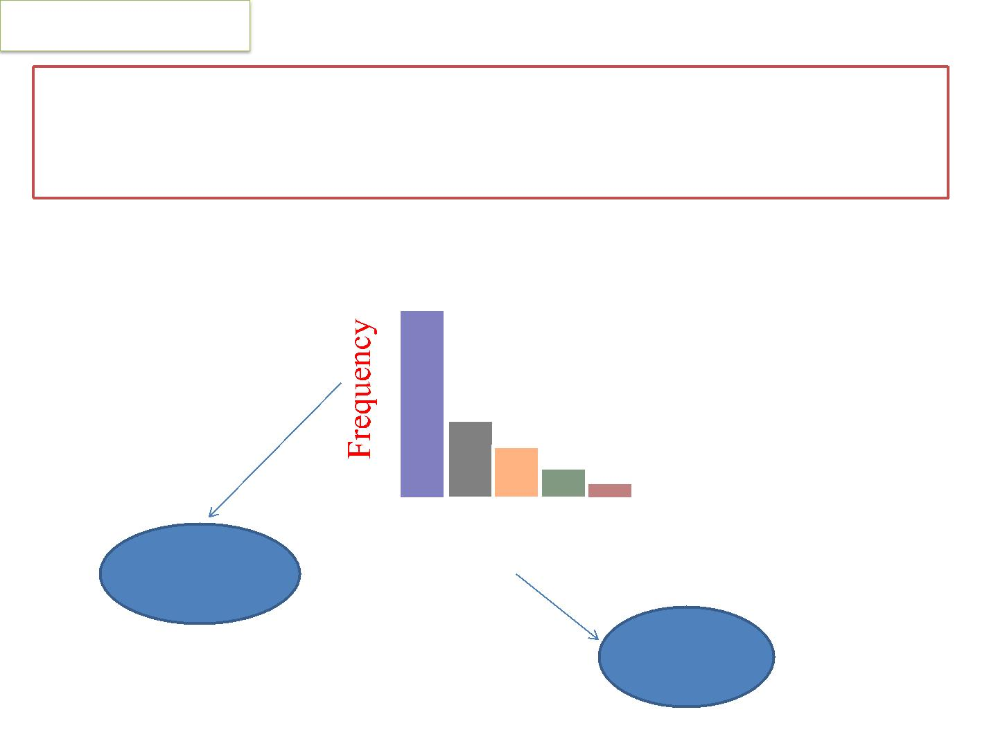
Pareto Diagram
A data display tool that breaks down discrete observations into
separate categories for the purpose of identifying the “vital few”
and separating them from the trivial many
C A B E D
Filtering
Reason
Sorting

Slide 17
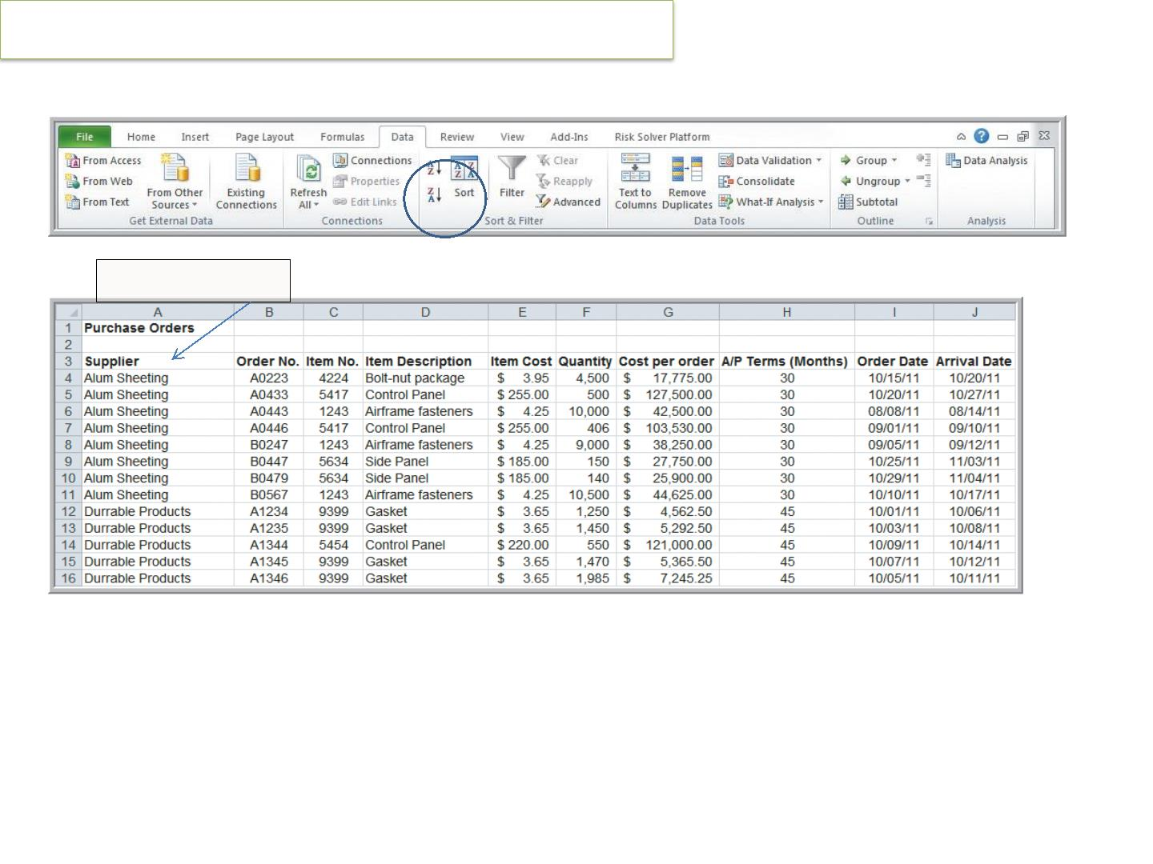
Data Queries: Using Sorting and Filtering
Sort by Supplier
eg. Sorting Data in the Purchase Orders Database

Slide 18
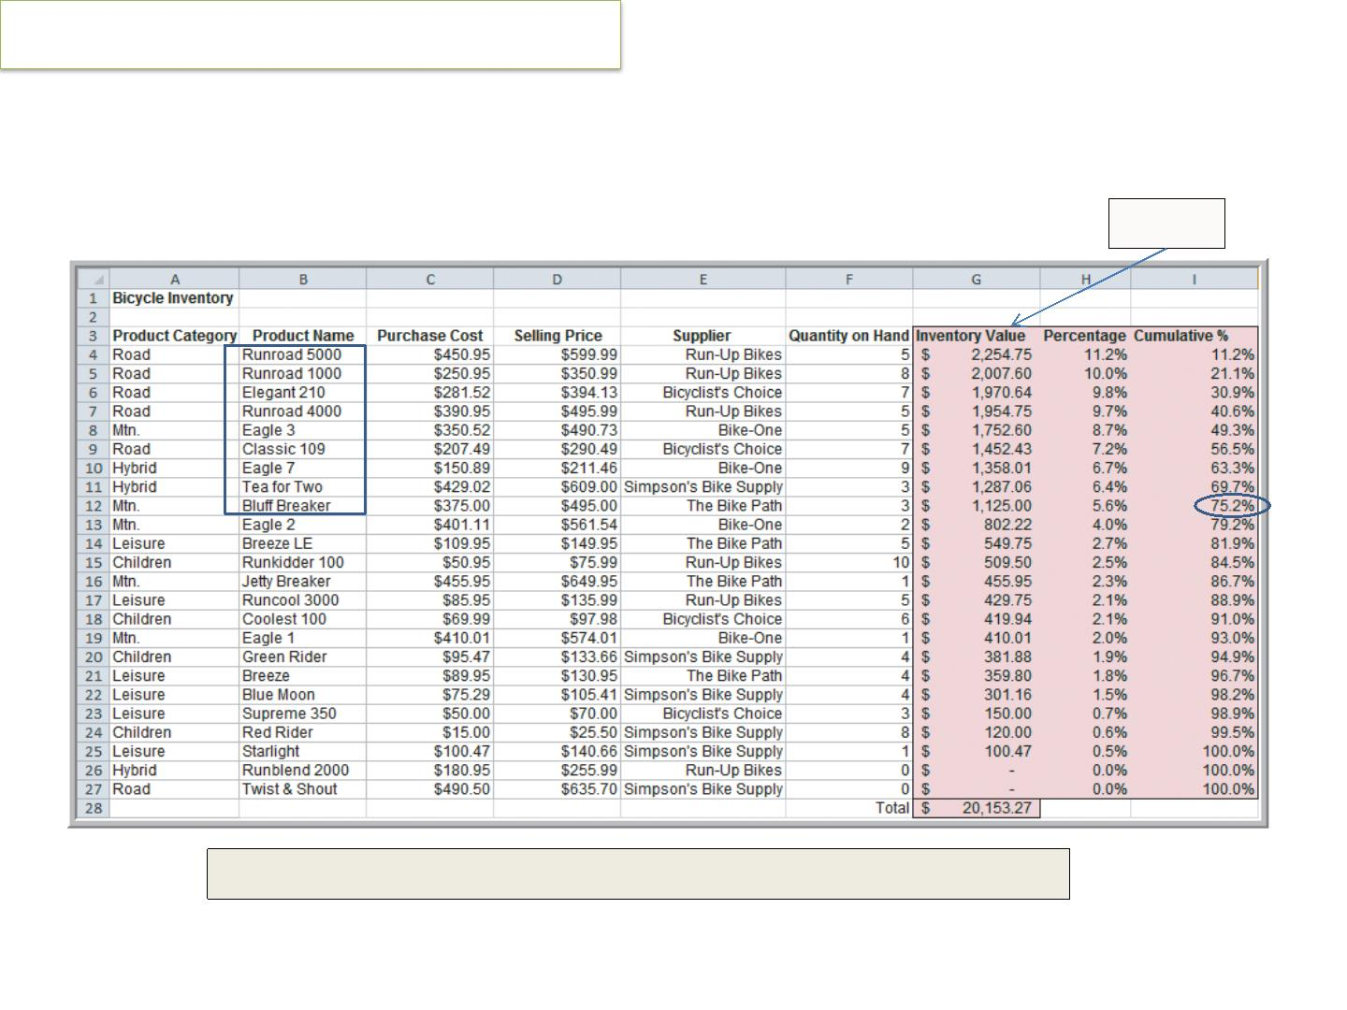
Applying the Pareto Principle
Sort by
75% of the bicycle inventory value comes from 40% (9/24) of items.

Slide 19
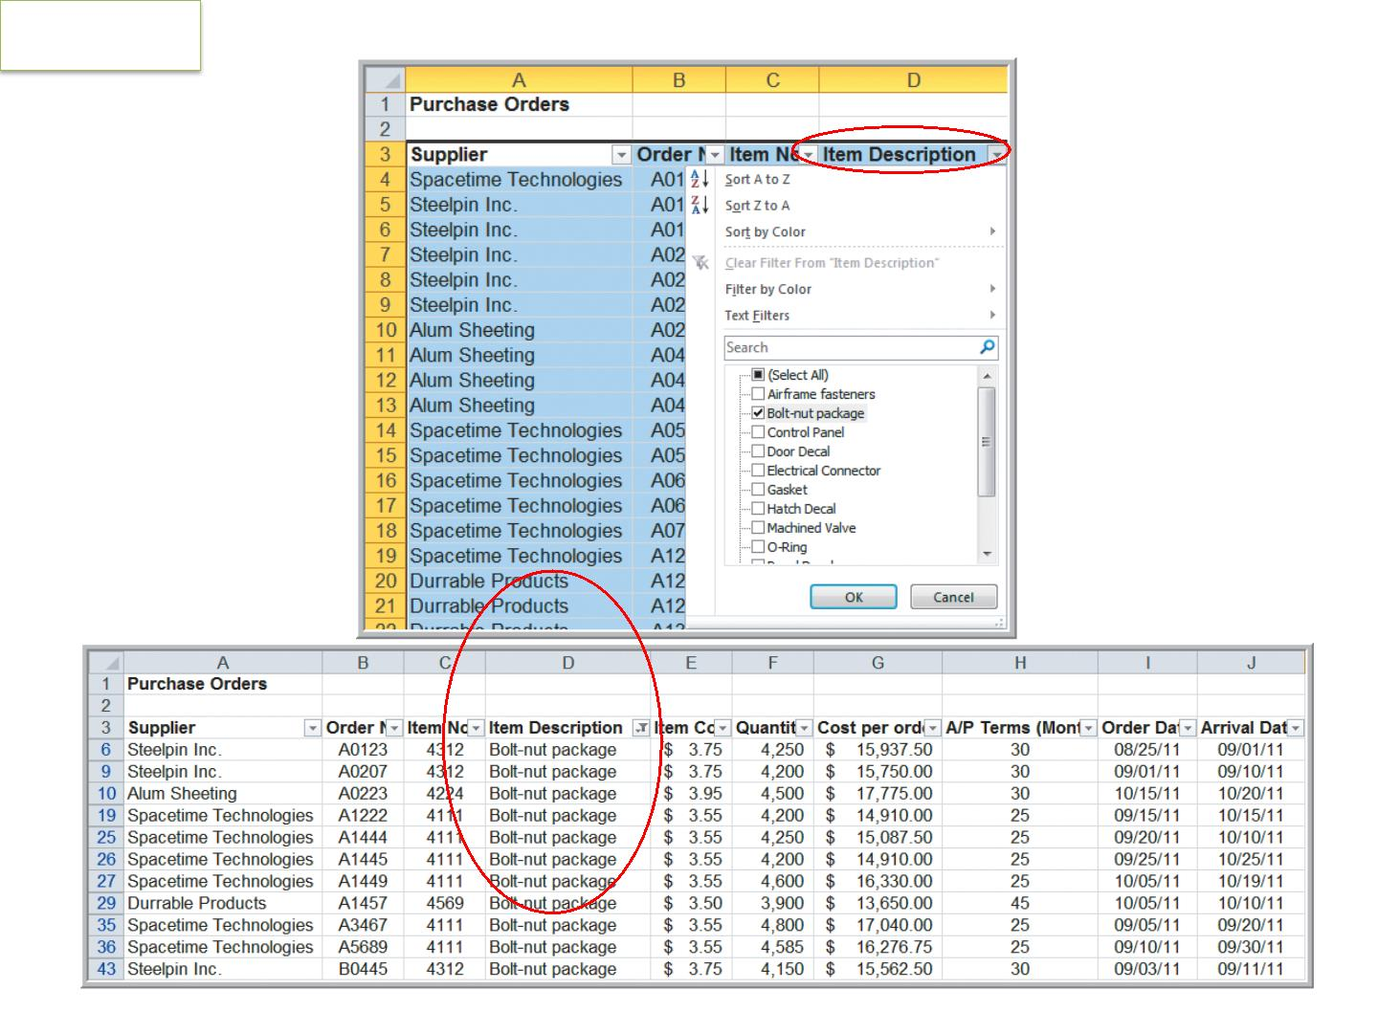
Filtering
Filtering Records by Item Description
Figure 3.17

Slide 20
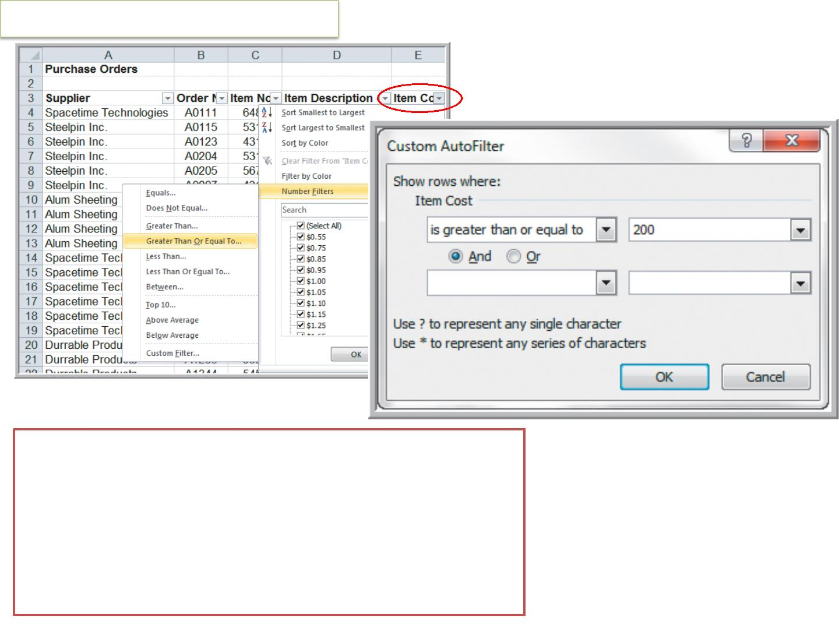
Filtering Records by Item Cost
AutoFilter criteria is based on the data type.


Number Filters includes numerical criteria.
Date Filters include tomorrow, next week, etc.
AutoFilter can be used sequentially.


First filter by one variable.
Then filter those data by another variable.

Slide 21
Thank You

